Slide 1
INTRODUCTION TO ASP.NET CORE
By: Bhawna Gunwani

Slide 2
ASP.NET CORE

Slide 3
ASP.NET Core Advanced Concepts

Slide 4
AGENDA
ASP.NET Core Request Pipeline
Built-In Middleware and Custom Middleware
ASP.NET Core Filters
Demo: Creating Custom Filters
Dependency Injection (DI)
Demo: Implementing DI in ASP.NET Core
Built-In Container Service
ASP.NET Core Environment Variables
Exception Handling and Logging

Slide 5
ASP.NET Core Middleware

Slide 6
MIDDLEWARE REQUEST PIPELINE
In this, requests are processed beginning with request and ending with response.
The pipeline specifies how the application should respond to the HTTP request.
The Request arriving from the browser goes through the pipeline and back.
The individual components that make up the pipeline are called Middleware.

Slide 7
ASP.NET Core Request Pipeline

Slide 8
MIDDLEWARE REQUEST PIPELINE
ASP.NET Application
Request Pipeline
Request
Kestrel
Middleware 1
Middleware 2
Middleware 3
Response

Slide 9
HOW MIDDLEWARE REQUEST PIPELINE WORKS
First, the Http Request arrives (directly or via External web server) at the Application
The Kestrel Web Server picks up the Request,
and creates the httpContext and passes it to the First Middleware in the request pipeline.
The First Middleware then takes over, process request and passes it to the next Middleware.
This goes on until it reaches the last middleware.
The last one returns the request back to previous middleware, terminating the request pipeline.
Finally, the response reaches kestrel, which returns the response back to the client.
Any of the middleware in the request pipeline can terminate the request pipeline by simply not
passing the request to the next middleware.

Slide 10
WORKING WITH MIDDLEWARES
Middleware 1
Middleware 2
Middleware 3
Request
//logic
next();
//more logic
//logic
next();
//more logic
//logic
next();
//more logic
Response

Slide 11
Built-In Middleware

Slide 12
BUILT-IN MIDDLEWARE
Microsoft introduced many inbuilt middleware with ASP.NET Components.
Middleware | Description
Authentication | Provide the authentication support for the application.
CORS | Used for configures Cross-Origin Resource Sharing.
Diagnostics | It is used to configures diagnostics
HTTPS Redirection | It is used to redirect all HTTP request to the HTTPs Service.
Request Localization | It provides the localization support.
Routing | This middleware provides the definition of the request routes.
HTTP Method Override | Provides us for the incoming POST request
MVC | Handles all the requests send or receive from the MVC or Razor pages.

Slide 13
Custom Middleware

Slide 14
CUSTOM MIDDLEWARES
The custom middleware component is like any other .NET class with Invoke() method.
However, in order to execute next middleware in a sequence, it should have RequestDelegate
type parameter in the constructor.
Custom middleware in.NET Core allows developers to execute code before or after request
response cycle.

Slide 15
ASP.NET Core Filters

Slide 16
ASP.NET CORE FILTERS
Filters allow us to run custom code before or after executing the action method.
They provide ways to do common repetitive tasks on our action method.
The filters are invoked on certain stages in the request processing pipeline.
Filters help us to remove duplicate codes in our application.
There are many built-in filters available with ASP.NET Core MVC, and we can create custom
filters as well.

Slide 17
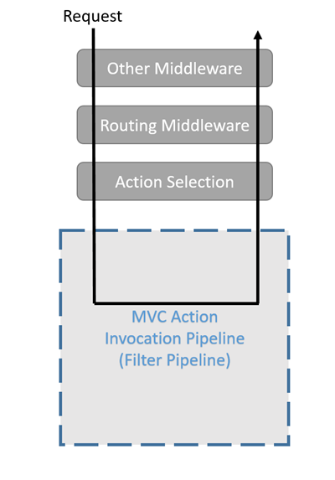
HOW FILTERS WORK?

Slide 18
ACTION FILTERS
An action filter is an attribute that you can apply to a controller action or an entire controller
that modifies the way in which the action is executed.
The ASP.NET MVC framework includes several action filters −
OutputCache: Caches the output of a controller action for a specified amount of time.
HandleError: Handles errors raised when a controller action is executed.
Authorize: Enables you to restrict access to a particular user or role.

Slide 19
TYPES OF FILTERS
The ASP.NET MVC framework supports four different types of filters −
Authorization Filters − Implements the IAuthorizationFilter attribute.
Action Filters − Implements the IActionFilter attribute.
Result Filters − Implements the IResultFilter attribute.
Exception Filters − Implements the IExceptionFilter attribute.

Slide 20
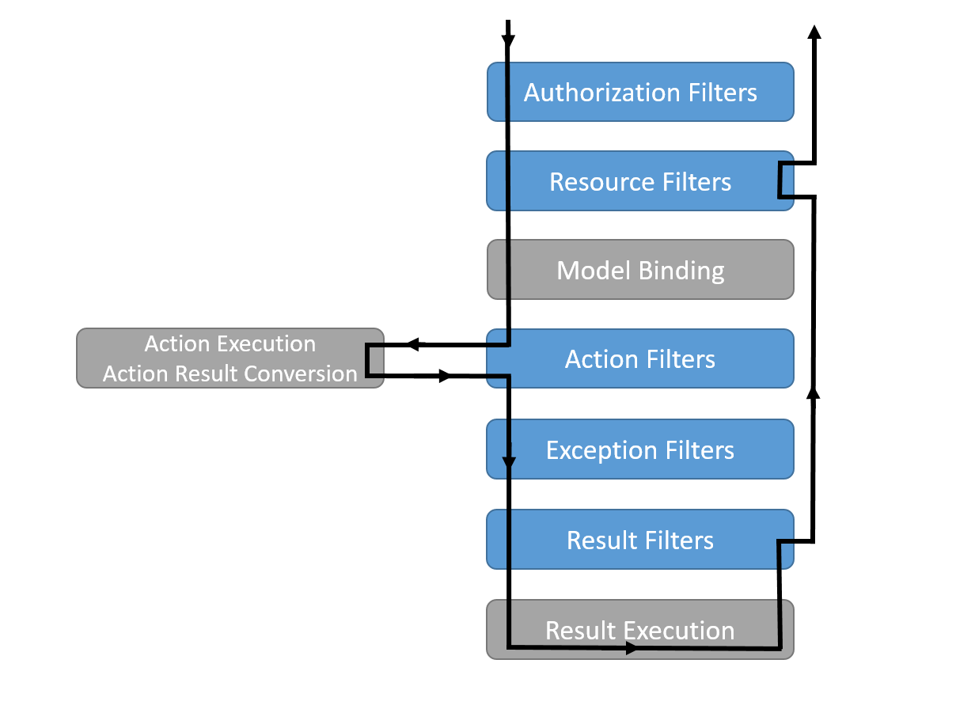
INTERACTION OF FILTER TYPES IN FILTER PIPELINE

Slide 21
DEMO
Creating Custom Filters

Slide 22

Thank You

Slide 23
Dependency Injection

Slide 24
DEPENDENCY INJECTION IN ASP.NET CORE
DI is used to achieve loosely coupling between objects,
so that applications can be maintained in an easy manner.
Here, DOT NET runtime engine automatically injects objects of dependency classes
It injects mainly through the constructor of the Controllers.
Thus, making the job of the developer much easier.
The concept of DI arises from a principle software design called Dependency Inversion Principle.

Slide 25
DEPENDENCY INJECTION IN ASP.NET CORE
Configuration in Startup Class
Component 1
Dependency Injection (DI)
Interface
Component 2

Slide 26
LOOSELY COUPLED ARCHITECTURE
In this, components or modules within a system have minimal dependencies on each other.
This means that each component can be easily upgraded without affecting other components.
Often used in distributed systems, where components are spread across different servers.
By decoupling the components, it becomes easier to scale the system.
It also makes the system more resilient to failures, as a failure in one component does not
necessarily cause the entire system to fail.

Slide 27
TIGHTLY COUPLED ARCHITECTURE
It is an architectural style where a number of application components are interdependent.
This means that a change in one component will likely impact other components.
For instance, a bank ATM relies on the hardware, built-in firmware and applications, and the
main banking app to enable a consumer to withdraw cash or use ATM-specific services.
The ATM will not function if any of these components fail.
It is generally easier to implement than more loosely coupled architectural styles, but can leave a
system more vulnerable to cascading failures.

Slide 28
TIGHTLY AND LOOSELY COUPLED ARCHITECTURE
Loosely Coupled:
Less Interdependency
Tightly Coupled:
More Interdependency

Slide 29
WHY IS TIGHTLY COUPLED CODE BAD?
It gives problems during the maintenance phase of the project. If one component changes then it will affect the other components also.
There will be lots of problems when performing the Unit Testing of these components.

Slide 30
TYPES OF DEPENDENCY INJECTION
The Services created by Dependency Injection have a lifetime which defines 2 things:
When they will be created.
How long they will remain in the memory before they are removed by the Garbage Collector.
Services can have 3 lifetimes:
Transient – created each time they’re requested.
Scoped – created once per client request (connection).
Singleton – only the first time they are requested.

Slide 31
DEMO
Implementing Dependency Injection in ASP.NET Core

Slide 32
Built-In Container Service

Slide 33
BUILT-IN IOC CONTAINER
ASP.NET Core framework includes built-in IoC container for automatic dependency injection.
The built-in IoC container is a simple yet effective container.
It is responsible for instantiating and injecting dependencies into objects at runtime
It does this by examining the constructors of classes and creating instances of any
required dependencies as needed.

Slide 34
ASP.NET Core Environment Variables

Slide 35
ASP.NET CORE ENVIRONMENT VARIABLES
ASP.NET Core Environment Variables uses the variable called ASPNETCORE-ENVIRONMENT.
It points towards the runtime environment.
The value of variable can be anything but usually be a Production, Staging, and Development.
The value is case insensitive in Windows and Mac OS but it is case sensitive on Linux.
The Environment variable defines the runtime environment for which the application runs.
They are mainly used to specify Environment application executing, enabling the application to
configure it.

Slide 36
ASP.NET CORE ENVIRONMENT VARIABLES
Environment Variables can be set to any of the values: Development, Production, or Staging.
Development:
-This process will be used during the application development;
-While using Visual Studio, the setting will be denoted in project’s debug, like IIS Express.
Staging:
- It is Pre-Production Environment used for testing after the application before deployment.
Production:
- The Production Environment is used while the application executes during the live process
where the end-user works on it.

Slide 37
Exception Handling

Slide 38
EXCEPTION HANDLING IN .NET CORE
Exception Handling is one of the important tasks in the application development cycle.
Below are the effective ways to handle the exceptions in .NET Core:
Exception Handling with Try-Catch Block
Global Exception Handling with Custom Middleware

Slide 39
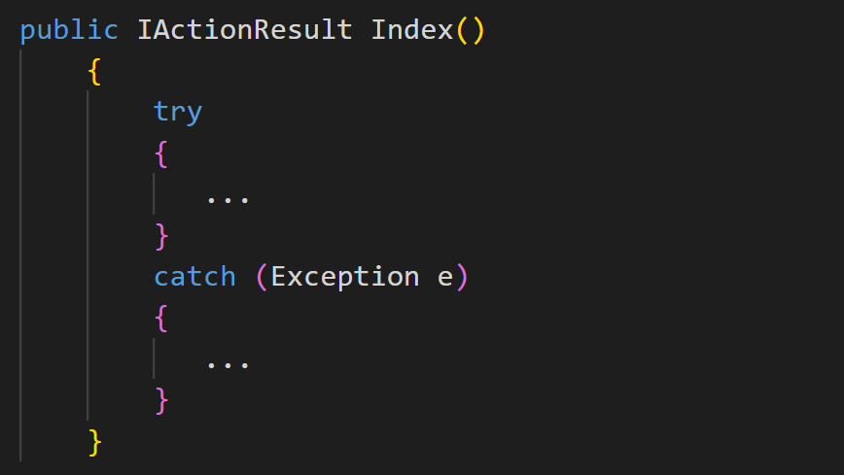
EXCEPTION HANDLING WITH TRY-CATCH BLOCK
The try block contains the code that may throw an exception,
and the catch block catches the exception and provides a way to handle it.
The finally block is optional and contains code that will be executed regardless of whether an
exception is thrown or not.

Slide 40
Imagine that you have many controllers and actions in your project and then you need to use try-catch for every action in controllers.
some times you have to use try-catch in the services. In that case, it increases the lines of code your project and it is not good.
This Problem can be handled by
Global Exception Handling with Custom Middleware

Slide 41
EXCEPTION HANDLING WITH CUSTOM MIDDLEWARE
This is a good and effective approach to handling the exception global level.
We could be caught all unhandled exceptions using this exception handler.
The benefit of using this approach is we could be caught all exceptions in one place,
and don’t need to use try-catch in every action to catch errors.
In that case, we need to create custom middleware to handle the exceptions.

